Slide 1
Chapter -2
Establishing Company Direction

Slide 2
Vision Statements
The vision statement describes the future of the organization. It reveals what the company aspires to be or hopes to achieve in the long-term. The vision statement is inspirational and motivational but also provides direction, mapping out where the organization is headed. In this regard, it serves as a guide for choosing current and future courses of action.
An effective vision statement should be brief, unmistakable, futuristic, realistic, aspiring and encouraging. It shouldn’t be broad but rather focus on outcomes specific to the organization.
When writing a vision statement, consider these questions:
Where are we going to move forward?
What do we want to achieve in the future?
What kind of future society do we imagine?
Example:
LinkedIn: To create economic opportunity for every member of the global workforce

Slide 3
Mission Statements
Mission Statement is the written declaration of an organization's core purpose and focus that normally remains unchanged over time. It guides the day-to-day operations of the organization, communicates to external stakeholders the core solutions the organization provides in society and motivates employees toward a common near-to-medium term goal. In short, the mission statement paints a picture of who the company is and what the company does.
When writing a mission statement, consider the following questions:
What do we do today?
Who do we serve?
What are we trying to accomplish?
What impact do we want to achieve?
Example:
LinkedIn: To connect the world’s professionals to make them more productive and successful.

Slide 4
Distinguish Between Mission and Vision
Basis | Mission | Vision
Meaning | Mission can be described as the quantitative goals of the organization which need to be achieved in the near future. | Vision can be described as the qualitative goals of the organization which are to be achieved in the long term.
Purpose | Mission defines the fundamental purpose of the organization. | Vision describes the outlines of the long-term aspirations and goals of an organization.
Timeframe | Mission includes short-term and near-future activities. | Vision includes long-term aspirations.
Scope | Missions have a limited scope. | Visions have a broader scope.
Main focus | Mission focuses mainly on specific activities, target audiences, and other specific activities. | Visions focus on broader goals, values, and aspirations.
Tangibility | Missions are more specific and solid. | Visions are more intellectual and motivational.
Stakeholders | Missions focus more on present stakeholders, including shareholders, directors, employees, customers, suppliers, etc. | Visions focus on society or the world as a whole.
Dynamic nature | Missions tend to remain more dynamic as per the prevailing conditions. | Visions more or less remain the same.

Slide 5
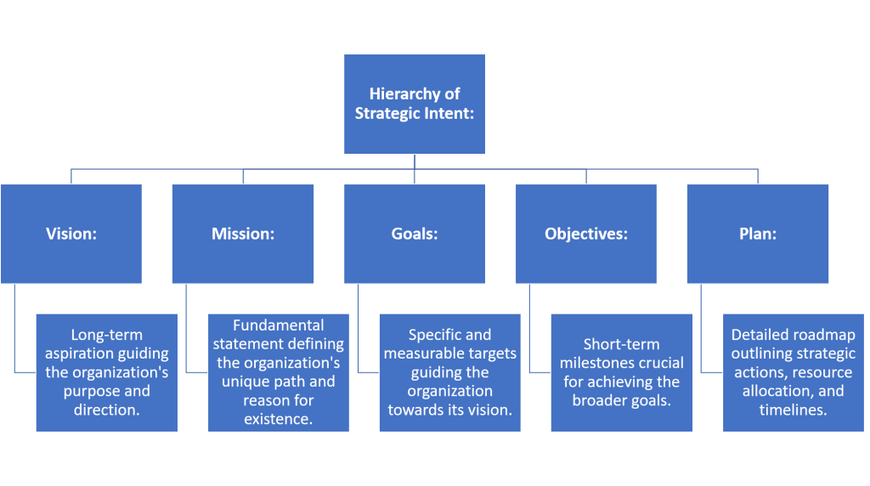
Hierarchy of Strategic Intent

Slide 6
Strategic intent is not just a singular concept but a structured hierarchy that includes several key components. Each level builds upon the last to create a complete roadmap guiding an organization towards its ultimate objectives. Here’s how each element fits into the hierarchy of strategic commitments:
Vision
At the top of the hierarchy is the vision, which articulates the organization’s long-term aspiration. The vision sets a broad, ambitious image of what the organization aims to become in the future. It serves as a guiding star for all strategic planning, aligning every action and decision with the organization’s ultimate purpose. For instance, a company might imagine itself as the leader in renewable energy technology.
2. Mission
The mission statement clarifies the organization’s fundamental purpose and separates it from other entities. It answers the question of why the organization exists and outlines the unique path it will follow to realize its vision. The mission provides a clear direction and framework for all operational and strategic decisions. It typically summarizes what the business does and its reason for existence.

Slide 7
Goals
Goals are specific targets that the organization aims to achieve within a set time frame. These are more concrete than the vision and are designed to be measurable and achievable, guiding the organization towards its larger aspirations. Goals help to translate the superior aspirations of the vision into practical, actionable benchmarks.
Objectives
Objectives drill down further into how the goals will be achieved. They are typically short-term or medium-term achievements that are crucial stepping stones towards meeting the broader goals. Objectives are specific, measurable, and time-bound, providing clear milestones that motivate and guide employees.
Plan
The plan details the steps the organization will take to meet its objectives and achieve its goals. It involves strategic actions, resource allocation, and timelines. Planning is an essential activity that includes the development of strategies to utilize resources effectively and address anticipated challenges. It ensures that every part of the organization is synchronized towards achieving the set objectives.

Slide 8
How to develop the strategic intent for the organization?
Developing a strategic intent for an organization involves careful consideration of the organization’s capabilities, aspirations, market position, and external environment. Here are some steps you could follow:
1.Clarify Vision and Mission: Understand the existing vision and mission of the organization. These elements provide a sense of direction and purpose. The vision is a broader concept that represents what the organization wants to achieve in the long term, while the mission reflects the organization’s core purpose and focus.
2.Assess Current State: Analyze the organization’s current situation, capabilities, strengths, and weaknesses. This could be done through tools such as SWOT (Strengths, Weaknesses, Opportunities, and Threats) analysis or PESTEL (Political, Economic, Sociocultural, Technological, Environmental, and Legal) analysis to consider both internal and external factors.
3.Understand the Market: Understand the market trends, competition, customer needs, and potential opportunities or threats. This understanding can help you identify potential aspirational areas grounded in market realities.

Slide 9
4.Define Objectives: Based on the previous steps, define clear, measurable, and achievable objectives. These objectives should guide the organization toward its vision.
5.Develop with a clear understanding of the vision, current situation, and objectives: You can now craft the strategic intent. It should be a concise, convincing statement that provides a long-term direction for the organization and motivates employees to strive to achieve it.
6.Communicate and Implement: Once developed, the organization must communicate effectively to ensure understanding and alignment. It should be embedded in all strategic initiatives, decision-making processes, and day-to-day operations.
7.Review and Adapt: Regularly review the strategic intent in light of changing market conditions, organizational capabilities, and other factors. Adapt or revise to keep it relevant and achievable if necessary.

Slide 10
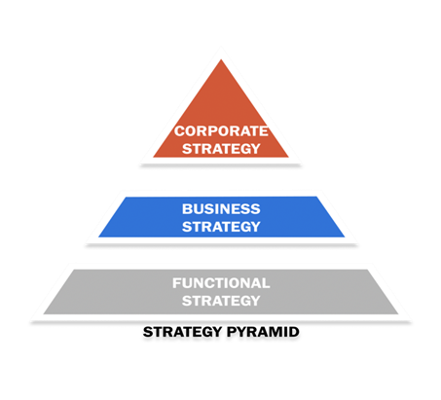
Levels of Strategies:
Figure 1: Three Levels of Strategy Pyramid

Slide 11
Strategy Level 1:
The corporate level is the highest and therefore the most broad, level of strategy in business. Corporate-level strategy should define your organization’s main purpose. It should also direct all your down-stream decision-making. For example, the objectives (e.g. high-level goals) in the levels below this one should all have a direct line to the goals defined here.
Creating and understanding your corporate-level strategy is particularly important for organizations that have multiple lines of business. For example, if one arm of your business manufactures a product and another arm sells that product, you’ll have a separate business unit strategy for each—but one single corporate-level strategy that describes why those two arms are important, and how those businesses interact for the good of the organization.

Slide 12
Strategy Level 2: The Business Unit Level
Your business unit strategy is used for different areas of your business (like services and products, or multiple departments or divisions, for example). The complexity of this level will depend on how many businesses you are in, and how your company is structured. It’s important to create a strategy for each business unit so that you can see which units are excelling and which need improvement.
Having a strategy at the business unit level allows you to weigh the costs and benefits of each business unit and to decide where you should spend your resources. Depending on the progress towards your goals and your analysis of the market, you may even decide it’s time to divest or sell some of your business units so you can focus on the areas that are most important to achieving your company’s corporate strategy.

Slide 13
Strategy Level 3: The Functional Level
The functional level of your strategy involves each department—and what those at the department level are doing day-to-day to support corporate initiatives. Whereas your business unit strategy would be defined and evaluated by senior leadership, your functional strategy is typically produced by department heads (e.g. leaders in marketing, operations, finance, IT, etc.).
These individuals can help ensure that the departments execute the defined strategic elements, and that the components laid out at the functional level help support both the department level and corporate level strategies.

